Slide 1

Purple Analytics
Restaurant Forecasting Web Application
Butch Cassidy Group

Slide 2
Contents
Team Members
Technology Stack
Project Description
Solution Walkthrough
Demo ?

Slide 3
Team Members
Chris Langeveldt | (Bsc III Computer Science)
Backend – Machine Learning
Markus Sass | (Bsc III Computer Science)
Backend & Frontend
Willem Wannenburg | (Bsc III Bioinformatics)
Frontend

Slide 4
Technology Stack
Frontend: ReactJS + [Apex Graphs]
Backend: Python + [Django, Pandas, LightGBM]

Slide 5
Project Description
Overview:
Web application, dashboard for forecasting order quantities, sales and other, smaller metrics.
Based on a user-system, such that similar restaurants could possibly draw from the models.
Restaurant owner uploads data, application processes it

Slide 6
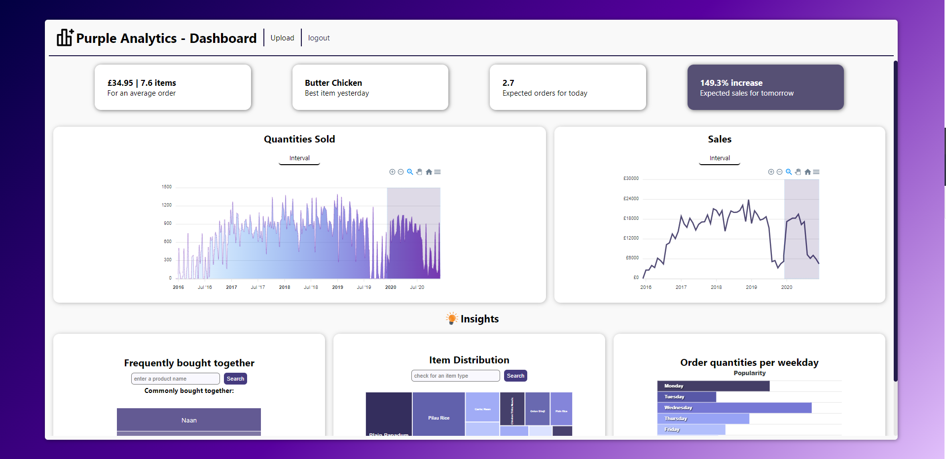
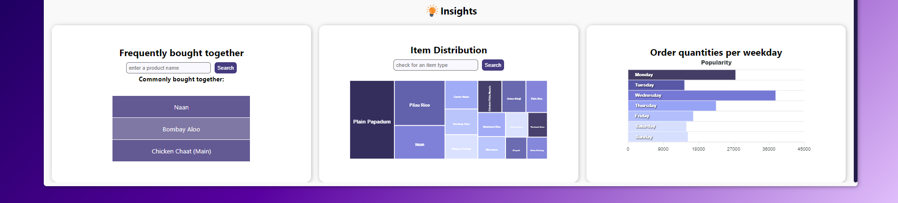

Slide 7
Project Description
Metrics in Application:
Global view of order quantities per day + forecasted for 12 months
Global view of total sales per day + forecasted for 12 months
Items commonly bought together based on a search
Treemap of popular items based on a search
Bar graph of quantity distribution per weekday
Average order value and number of items
Expected number of orders for today
Prediction of sales change for the next day

Slide 8
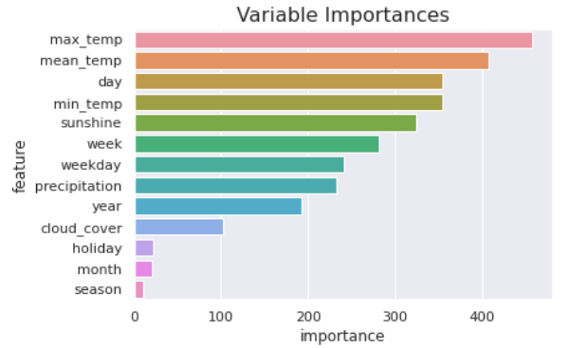
Solution Walkthrough
Light Gradient Boosting Machine – efficient, accurate, ease of use
Data included for predictions
Weather – cloud cover, sunshine, max temperature, mean temperature, min temperature, precipitation
Holidays
Day, Week, Month, Year
Day of week
Season

Slide 9
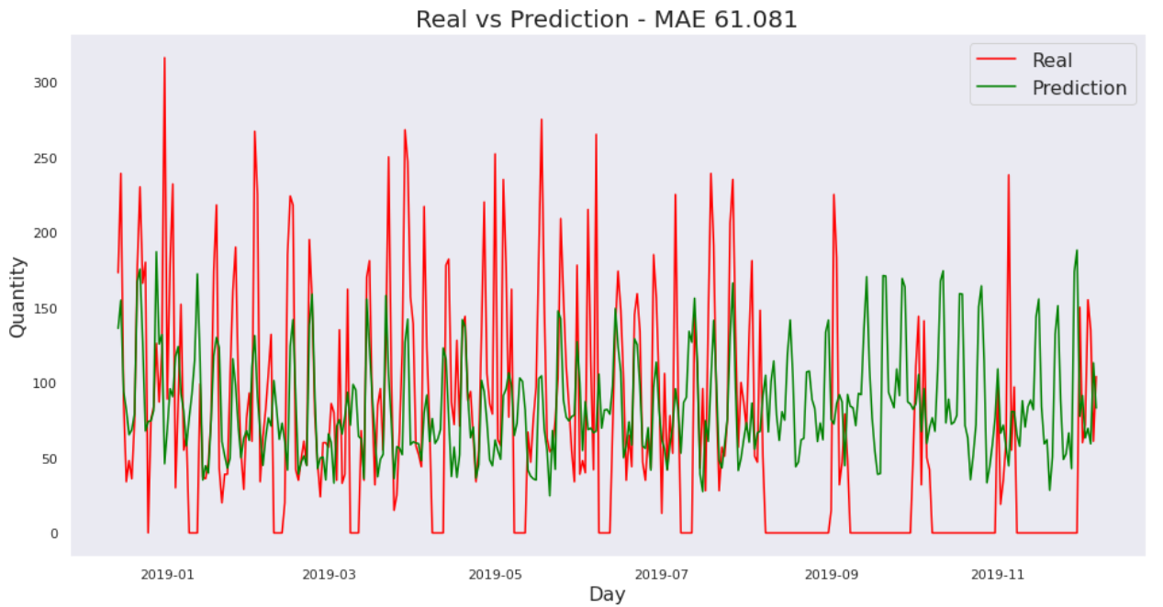
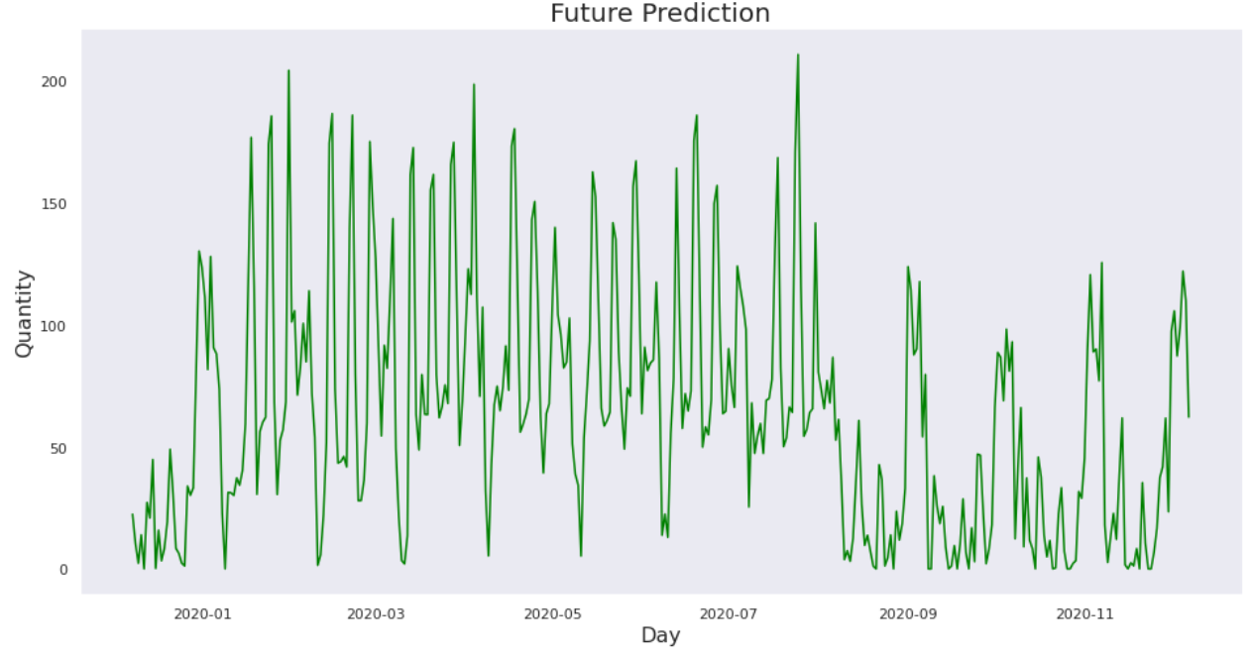
Solution Walkthrough
Data Trained and Tested on total quantities per day

Slide 10
Thank you
Send

